Slide 1
Promoting mental well-being and resilience among older adults and their caregivers in Africa: Challenges and the way forward
Presented by
Professor Uzoma O. Okoye
Dept of Social Work
University of Nigeria,
Nsukka
WAZEE Day Celebration of Older Persons on October 6th, 2023

Slide 2
OUTLINE
Why address mental well-being and resilience
Problems that can impact the mental well-being and resilience
Key issues about older adults and their caregivers in Africa
Barriers to promoting mental well-being and resilience
Conclusion
Definition of key concepts
Strategies for promoting mental well-being and resilience

Slide 3
Definition of terms
Older adults in this presentation are regarded of persons who are 65 years and above
Mental well-being can be described as a combination of emotions and life satisfaction among older adults and their caregivers and how they function in their relationships with others.
Caregivers are individuals who provide paid, unpaid or informal care to older adults. In Africa, they are typically family members or friends
Resilience is the process and outcome by older adults and their caregivers to successfully adapt to challenging life experiences, especially through mental, emotional, and behavioural flexibility.

Slide 4
Formal and Informal social support for older adults in Africa
Formal Support
Pension for those that worked for the government
Health insurance
Old age social security benefits
Unconditional cash transfers

Slide 5
Formal and informal social support for older adults in Africa
Informal Support
Political patronage during electioneering campaigns
Philanthropists
Families
NGOs, CBOs and FBOs
Friends

Slide 6
Caregiving and older adults in Africa
Caregiving is mostly informal by family members and friends and unpaid
Because it is unpaid, majority of caregivers have their primary job and so they are under a lot of stress
When it is paid for, majority of caregivers are untrained in caregiving for older adults
This is can lead to elder abuse and depression on the part of older adult and sense of guilt on the part of the caregiver

Slide 7
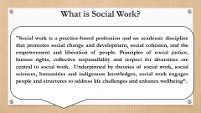
Reasons for addressing mental well-being and resilience in older adults
They encourage optimistic and proactive approach to life making people to move through and even be strengthened by challenges they face.
They play important roles in recovery from adversity thereby increasing the individuals opportunity to make the most out of life
They both have high impact on people’s ability to carry out basic daily living activities, reducing their independency, autonomy and quality of life.
Without both, people become more emotionally sensitive, more prone to lashing out or even get increasingly anxious thereby making everyone tense
They help protect people from various mental health conditions, such as depression and anxiety and also offset factors that increase the risk.

Slide 8
Problems that can impact the mental well-being and resilience of older adults and their caregivers
1) Financial Problems
5) Health challenges/Disability
4) Loneliness and Isolation
3) Loss, in bereavement and changes physical space
2) Problems in family relationships

Slide 9
Barriers to promoting mental well-being and resilience among older adults and their caregivers
Lack of access to mental health services
Finance
Lack of awareness of what constitute mental well-being
Stigma and negative perception of mental health services
Culture/Religion
Lack of trained social workers
Absence of supportive family and networks

Slide 10
Strategies for promoting of mental well-being and resilience among older adults
Strategies
Training of health professionals in providing care for older people
Provision of healthy and nutritional meals to older adults
Availability of modern and innovative mental health services in Primary Health care centres
Care givers should encourage older adults to engage in physical excercise
Provision of adult–day care centres and half way homes
Encourage older adults to learn new skills and maintain social interactions and relationships
Provision of counselling and other services to older adults by social workers

Slide 11
Strategies for promoting of mental well-being and resilience among care givers
Strategies
Appreciation and empowerment of caregivers
Access to counselling, mental health services and support groups
Opportunity to take some time off from caregiving activities
Provision of training in the art of caregiving for caregivers

Slide 12
Conclusion
Positive mental well-being give rise to resilience among older adults and their caregivers. Therefore, it is important that professional such as social workers assist older adults and their caregivers to navigate the caregiver/care-receiver relationship. This will go a long way in improving their wellbeing and developing resilience to help them live more fulfilled lives.

Slide 13
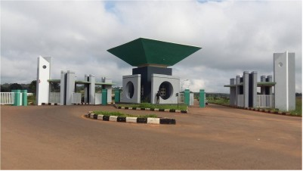
THANK YOU FOR LISTENING

