Slide 1
Social Work and Development Work with Older Persons
African Union (AU) Policies & Philosophy
Dr Rugare Mugumbate

Slide 2
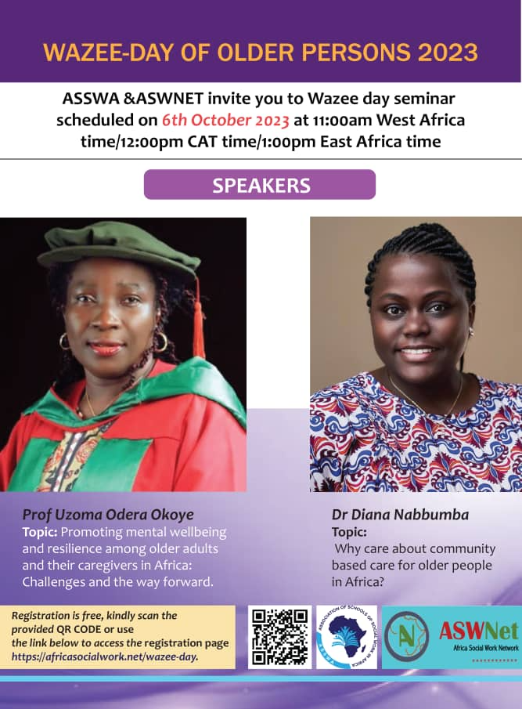
Contents
Two major AU policies on older people
Framework and Plan of Action on Ageing:
Family and Community focus
Key approaches
Philosophy and theories behind AU framework
Sources of literature and other resources

Slide 3
Major AU Policies on
Older People
Protocol
Framework and Plan
Policy Framework and Plan of Action on Ageing, 2022 under revision
(put in place in 2002)
Protocol on the Rights of Older Persons, 2016

Slide 4
Policy Framework and Plan of Action on Ageing, 2022
7 core guiding principles with several approaches
11 strategic action areas
6 stakeholder groups and their roles

Slide 5
“6. Africa looks to families and their communities as key social groups in which older people’s lives unfold and which challenges and opportunities of later life are to be understood. At the same time – and whilst recognising the strain on families’ capacities and resources – Africa looks to families and communities as a strength upon which development in the continent can and must build”.
Core Guiding Principle B4
Supporting Families and Communities

Slide 6
“7. The development of responses on ageing and older persons across all strategic areas, ought therefore, consider where and how existing family and community arrangements and initiatives can be leveraged and built upon. This must ensure that the capacities and resources of communities and families across contexts are adequately supported to respond to the needs and be responsive to the will and preferences of older persons.”
Core Guiding Principle B4
Supporting Families and Communities

Slide 7
4 Key Approaches of Principle B4
Supporting norms and values
Being family & community-based
a) Develop a robust and grounded understanding of the heterogeneity in African family forms, circumstances and dynamics and the experiences of individuals within them; of the norms and values that underpin families and communities; and of the resources and capacities that families and communities draw upon
b) Map and draw lessons from existing family- and community-based responses on ageing and older persons
Stakeholder engagement
Resourcing
d) Ensure adequate resourcing, including through social protection, to support the capacities of families and communities as part of ageing-focused responses
c) Establish and sustain stakeholder-engagement mechanisms and platforms to ensure that families and communities are included in the development of responses on ageing and older persons

Slide 8
www.africasocialwork.net/ubuntu

Slide 10
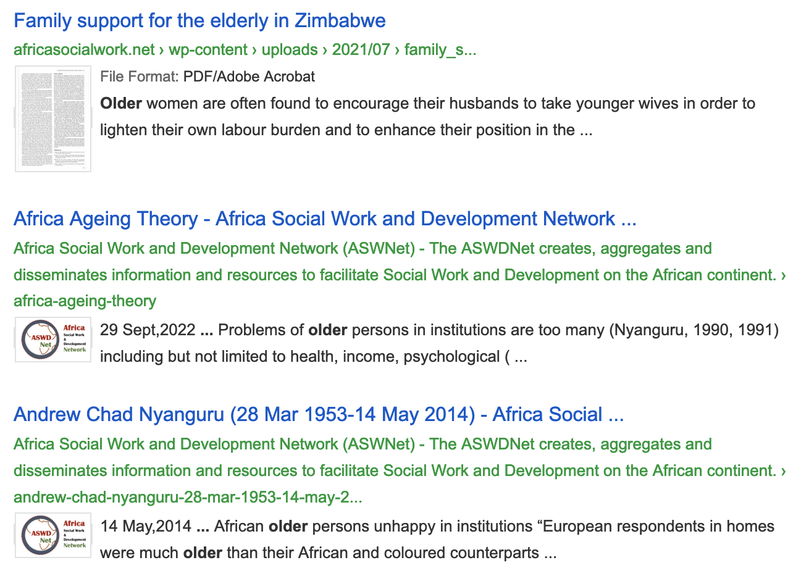
Theories of Ageing
100+ Africa theories on ASWDNet website
Where to get literature (or publish) and other resources on aging, Ubuntu?

Slide 11
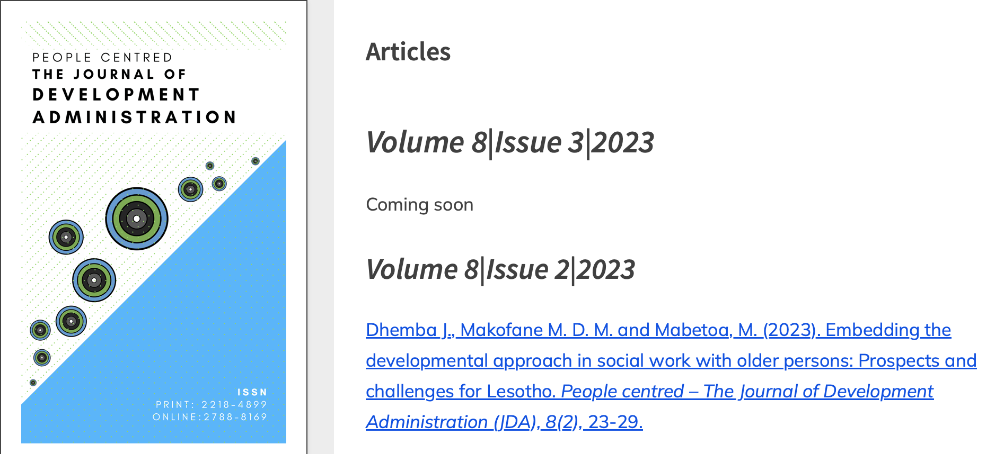
Journal of Development Administration

Slide 12
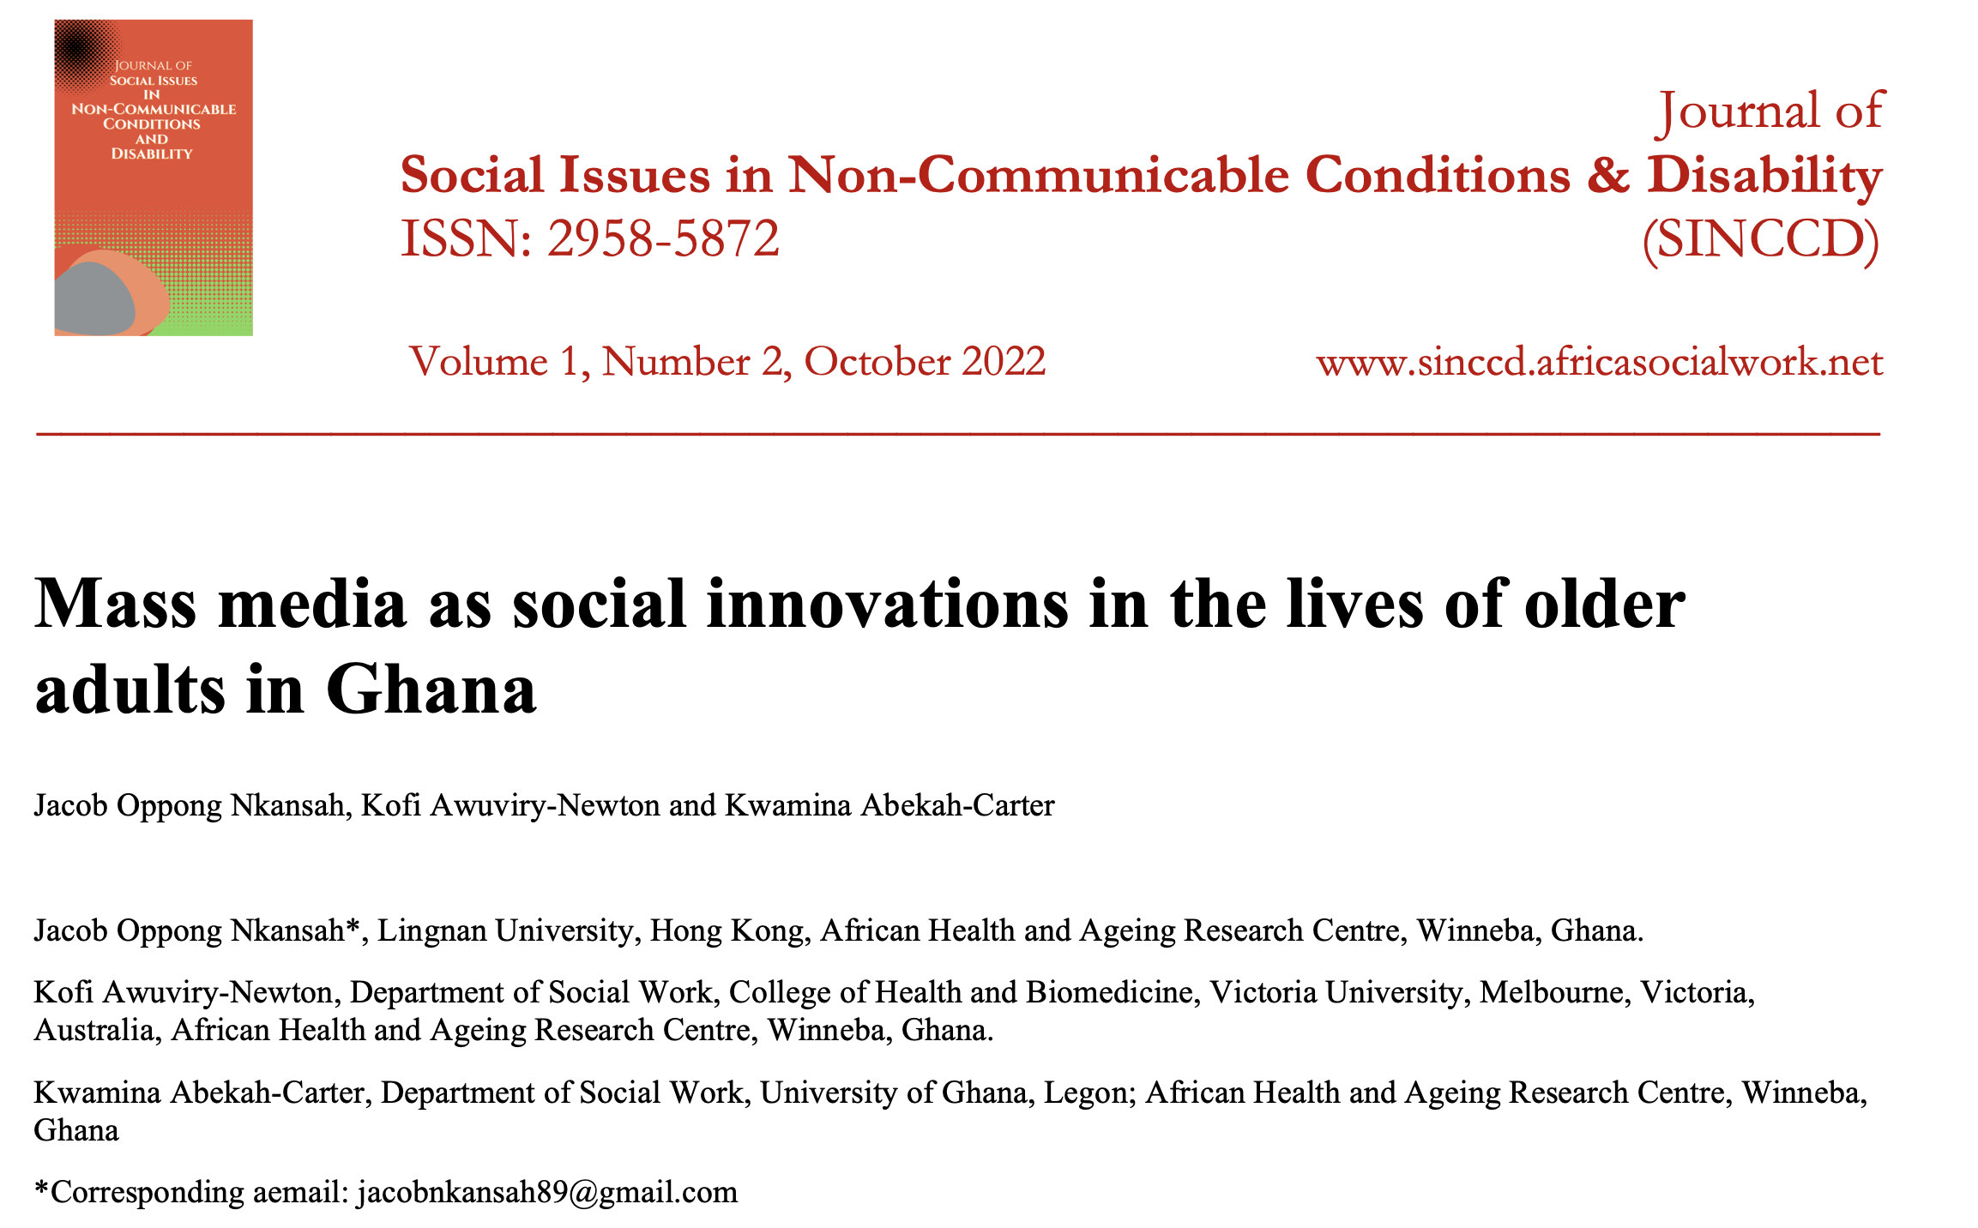
Journal of Social Issues in NCDs & Disability

Slide 13
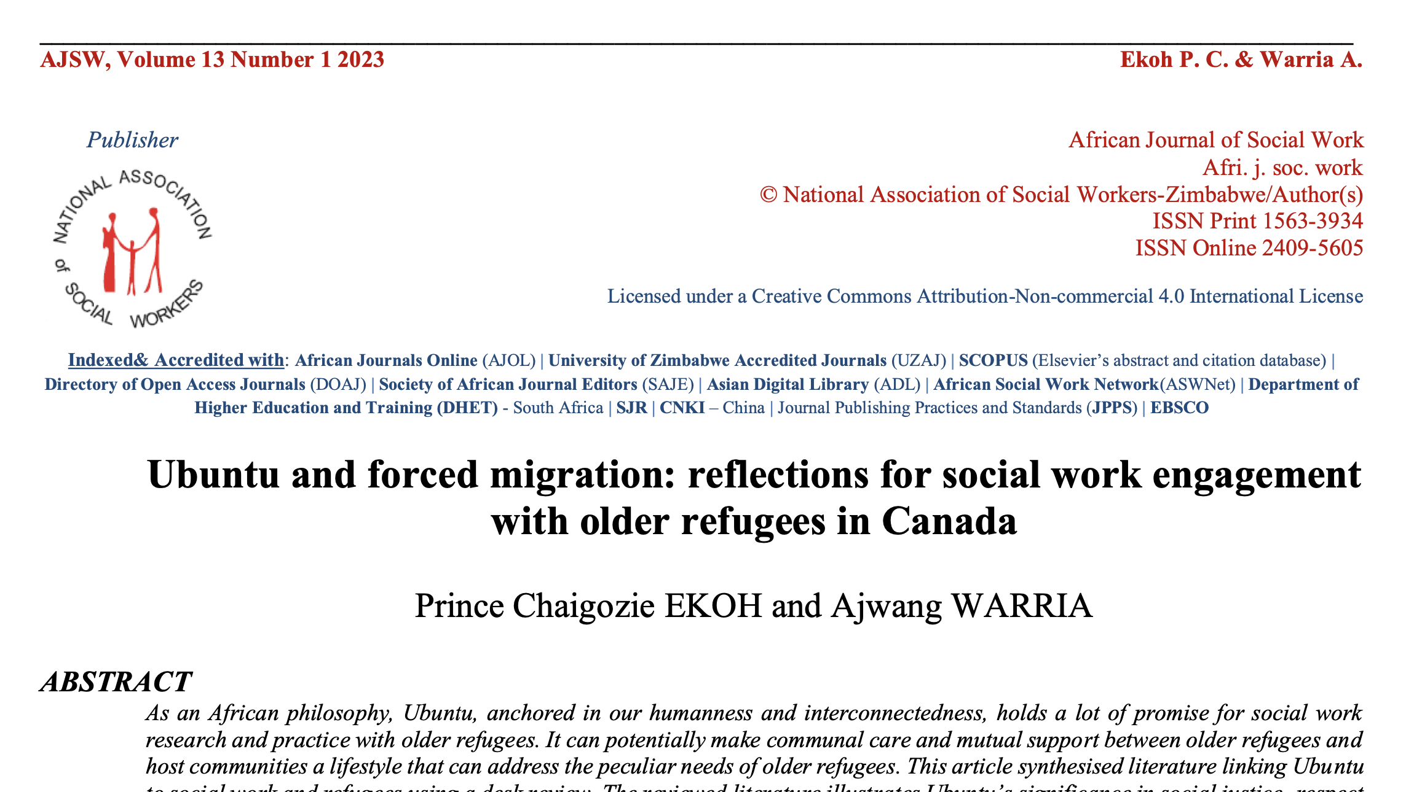
African Journal of Social Work

Slide 14
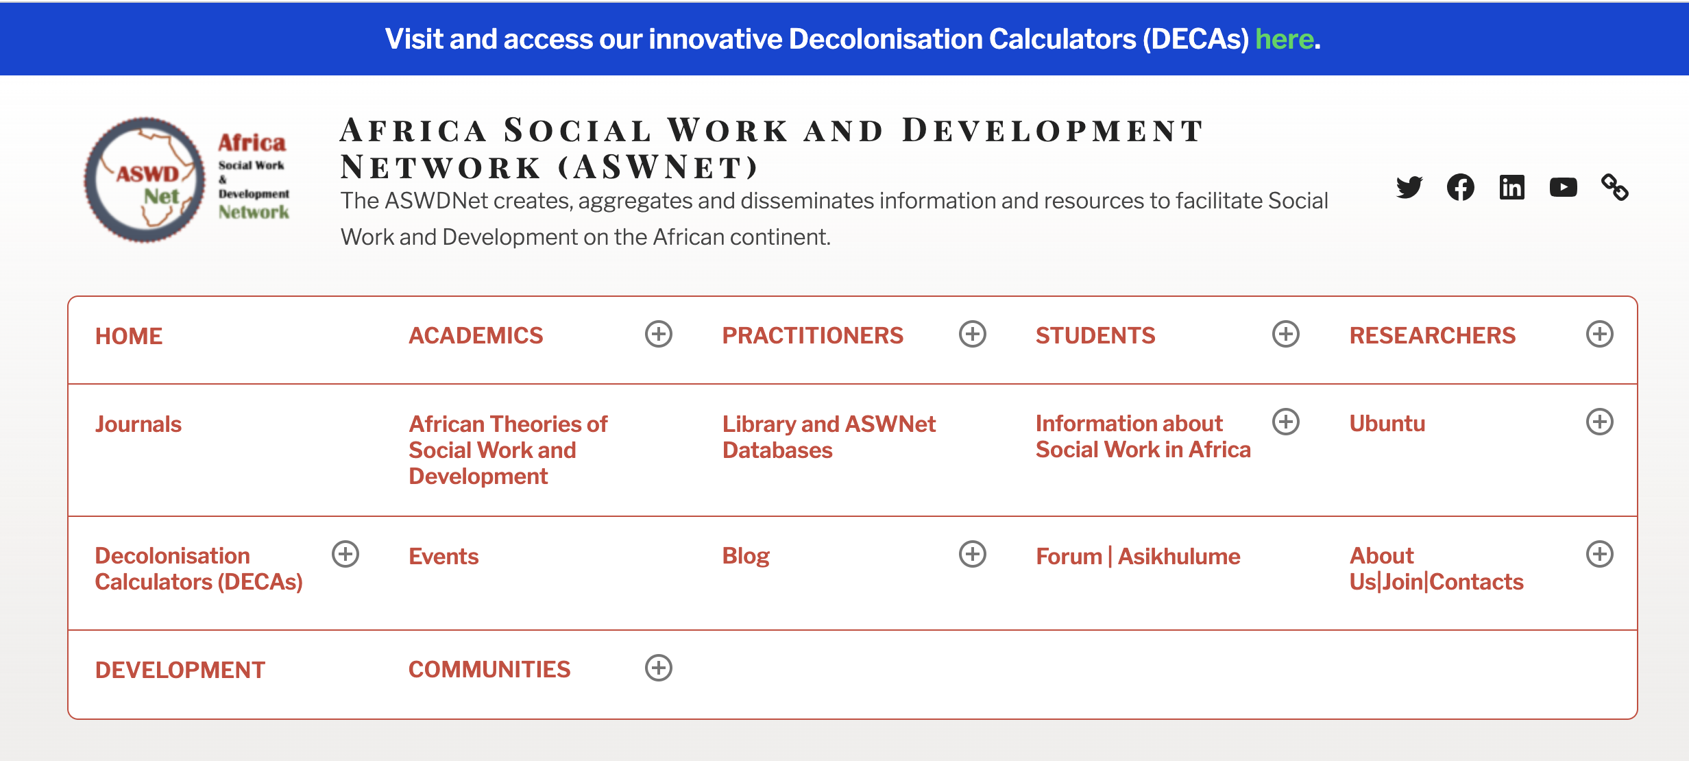
www.africasocialwork.net

Slide 15
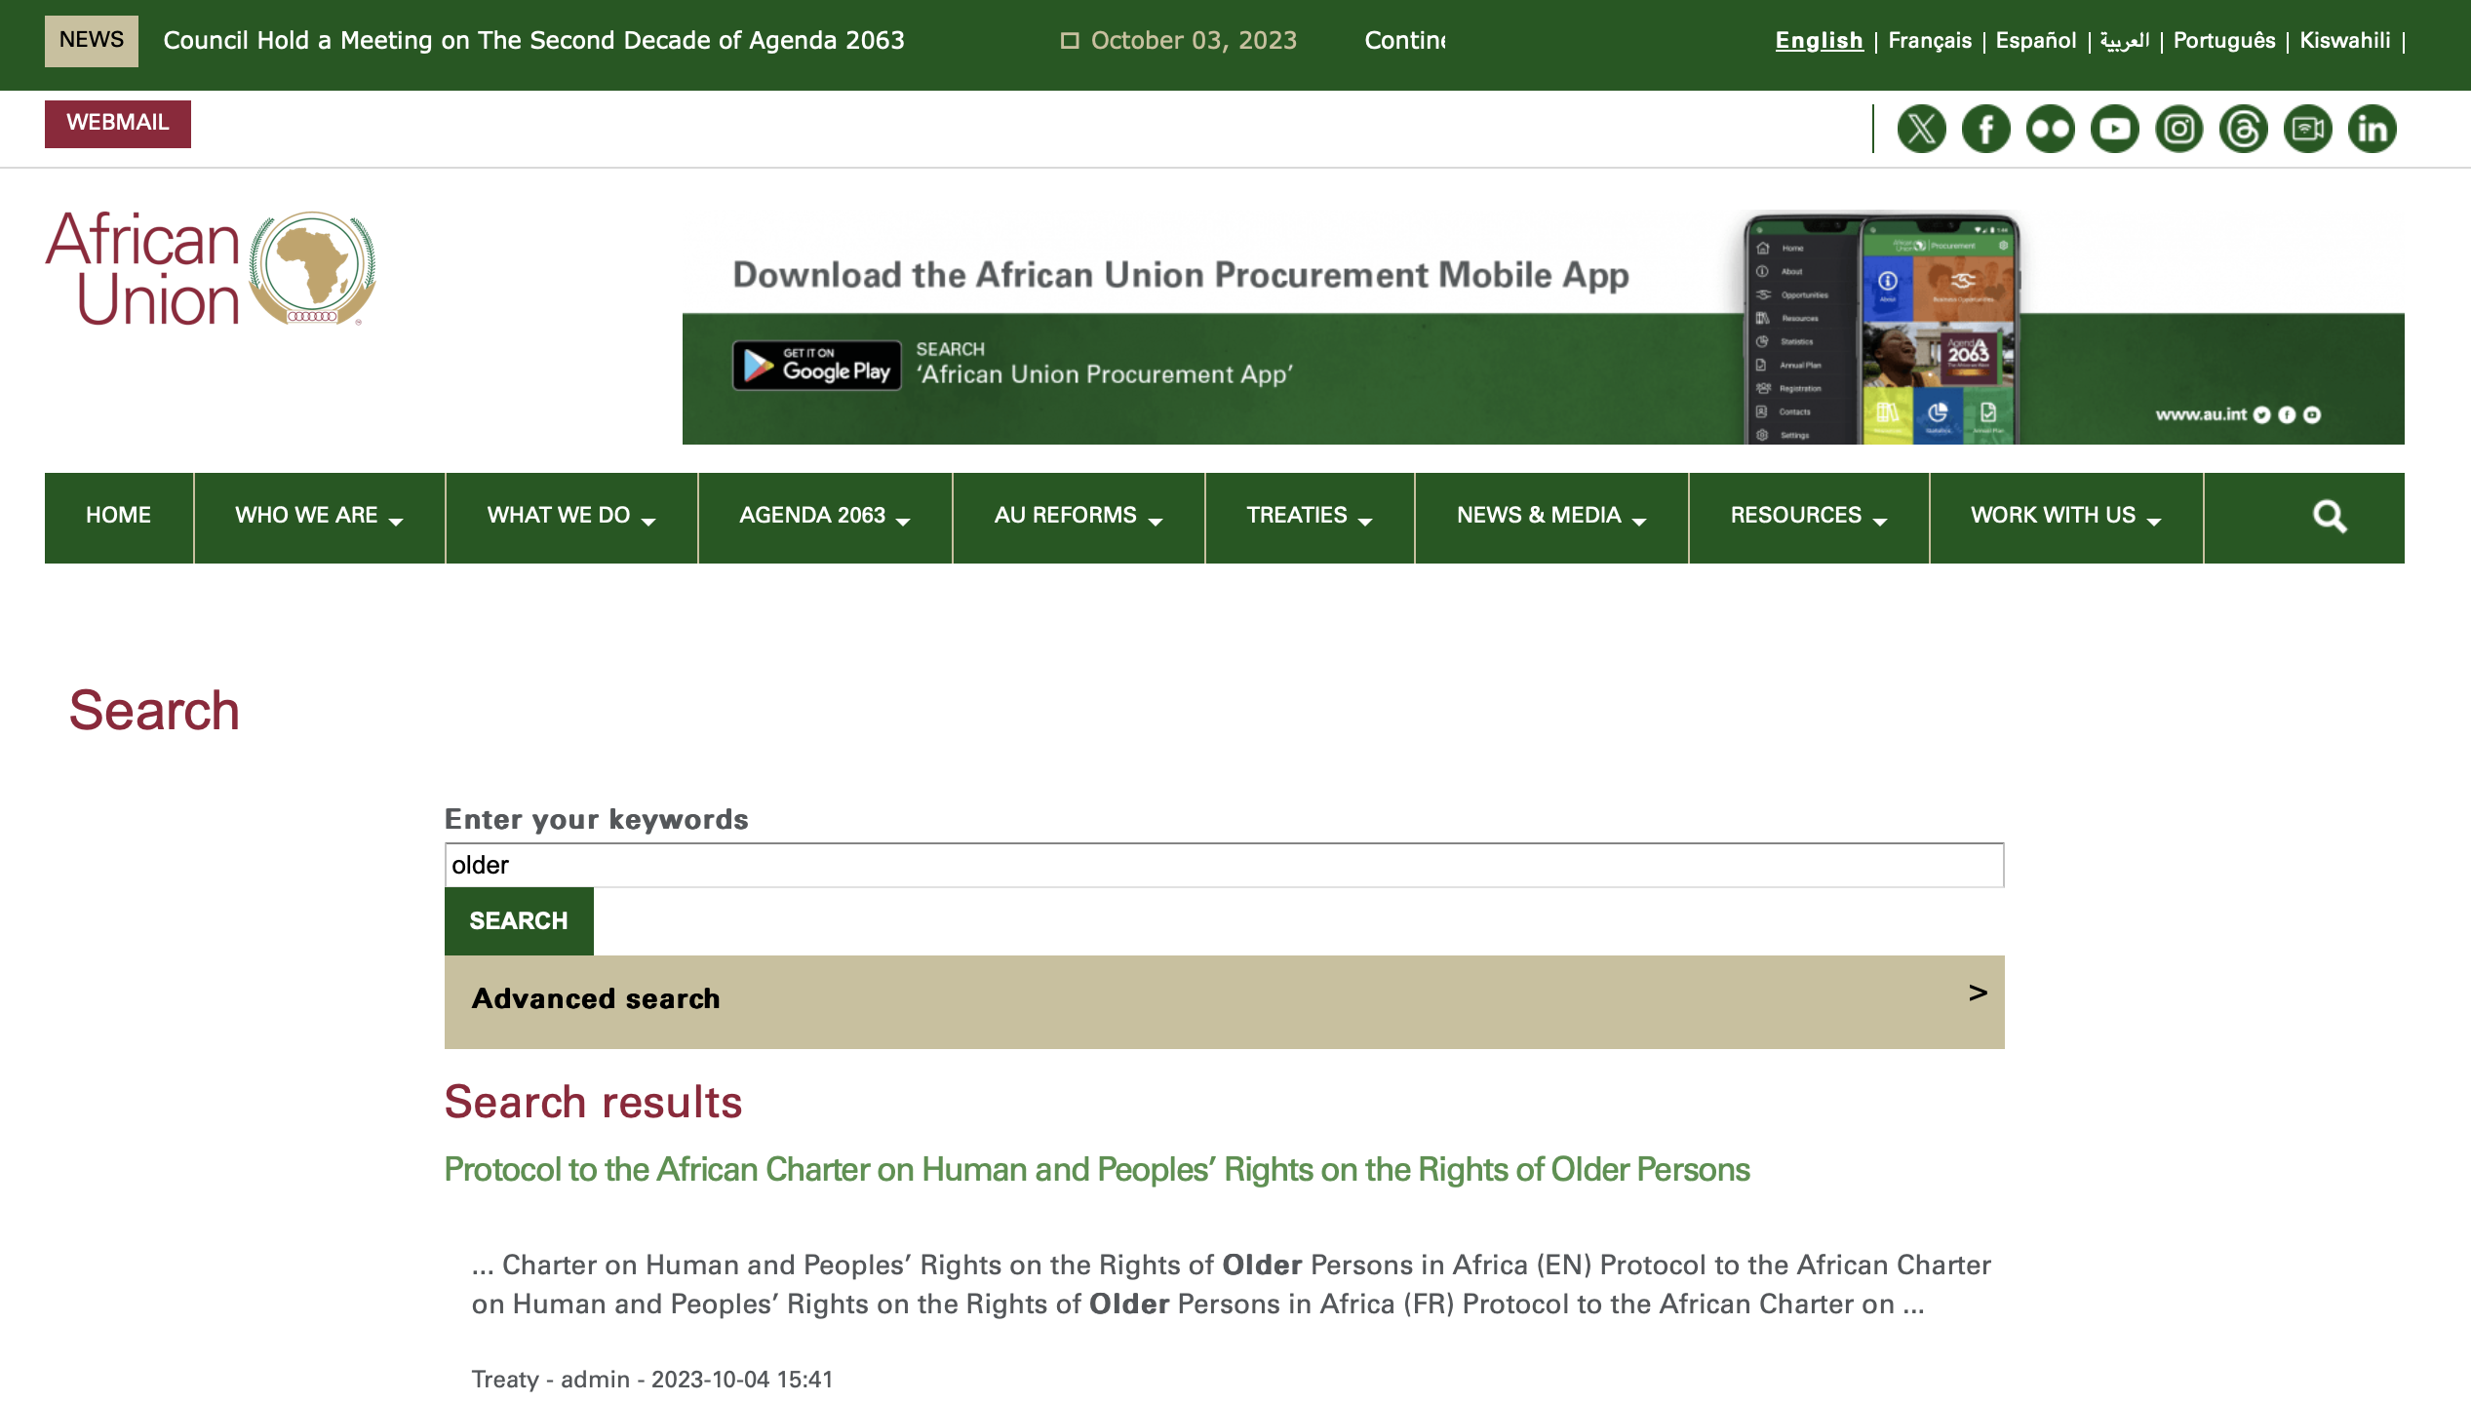
www.au.int
Country laws, policies and plans

Slide 16
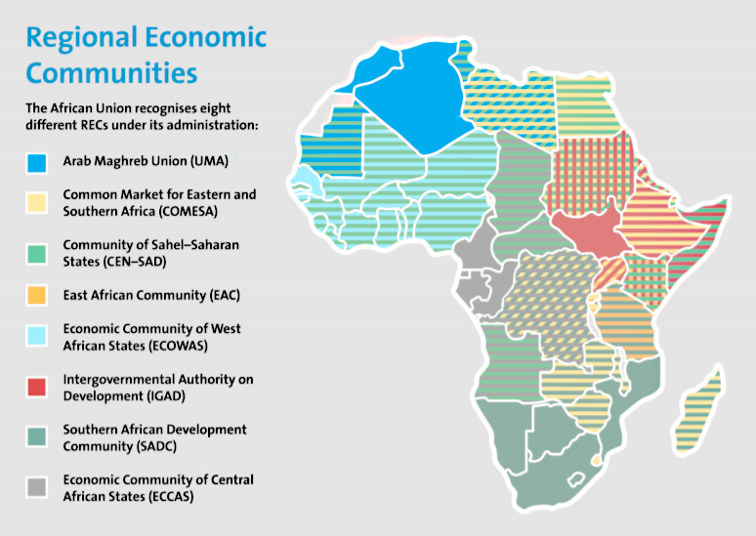
Regional policies and plans
Notes:
Regional bodies
Arab Maghreb Union (UMA)
Common Market for Eastern and Southern Africa (COMESA)
Community of Sahel–Saharan States (CEN–SAD)
East African Community (EAC)
Economic Community of Central African States (ECCAS)
Economic Community of West African States (ECOWAS)
Intergovernmental Authority on Development (IGAD)
Southern African Development Community (SADC).

Slide 17
You are all invited
8 December 2023

