Slide 1
SOLARPUNK
CREATING A SUSTAINABLE FUTURE FOR THE AFRICAN CHILD
BY OKOROAFOR CHRISTABEL .E.

Slide 2
What is Solarpunk?
It is a speculative literary genre and a subgenre in climate activism that depicts a possible future where technology and nature exist in ecological harmony/symbiotism. It is also known as a form of Ecotopia (Ecological Utopia).

Slide 3
Steampunk references history precisely the Victorian Era with the primary source of energy being the Steam engines.
Other types of Punks
Steampunk
Cyberpunk
Solarpunk
This depicts a future that is tech ridden and completely computerized.
Solarpunk is like a rebellion against the stereotypical future for man describe with images that are grim and a possible extinction or apocalypse.

Slide 4
WHY??
Solarpunk is focused on the essence of African Philosophy of being a whole person and being one with your surroundings, particularly focusing on community and its strength, a core concept for the Africa scene.
It reinforces a hopeful mindset that should fuel social action or raise questions and discourse about the future of climate change in Africa and amongst Africans.

Slide 5
CHARACTERISTICS OF SOLARPUNK
Afrofuturism
Ecological awareness
Long term design
Greentech
Green architecture
Ecovillages and Community
Sustainable architecture/products
Anti consumerism & Anti capitalist society
**Sustainability in general not Faux-sustainability**

Slide 6
PRACTICAL APPLICATIONS FOR THE SOLARPUNK CONCEPT
Urban greenhouses,
Gardens, homesteads & Ecovillages; community gardening
Treated wastewater, geothermal heating & rainwater harvesting
Renewable energy; solar power, hydro & wind
Decentralized technologies like blockchain, peer-to-peer networks, Web3. Ethical sourced, community focused solutions.
Permaculture, systems in large and small scale
Regenerative design
Tool libraries
Maker spaces
Positive psychology &Metacognition.
Greentch,
Upcycled goods.
City planning

Slide 7
THE AFRICAN CHILD AND CLIMATE CHANGE: SOLARPUNK CONCEPT
How can we protect the African child?
CLIMATE AWARENESS
COMMUNAL LIVING
UPHOLDING AFRICAN PHILOSOPHY OF ONENESS, EQUALITY AND PRESERVATION OF THE CIRCLE OF LIFE
COLLECTIVE ACTION AND SOCIAL ACTION
Ecological ethics expanding on wider social awareness and the dissolutions of problematic social constructs.
Exemplary Social action as it fosters the understanding of the importance of community, African heritage and pride for the African child and builds up the African child to be enlightened and given opportunity to take action in whatever where possible.
** Giving a voice to the African child and equipping them to be knowledgeable**
** Active participation in their communities**

Slide 8
SINGAPOREAN GREEN BUILDINGS

Slide 9
ALMAT FARMS

Slide 10
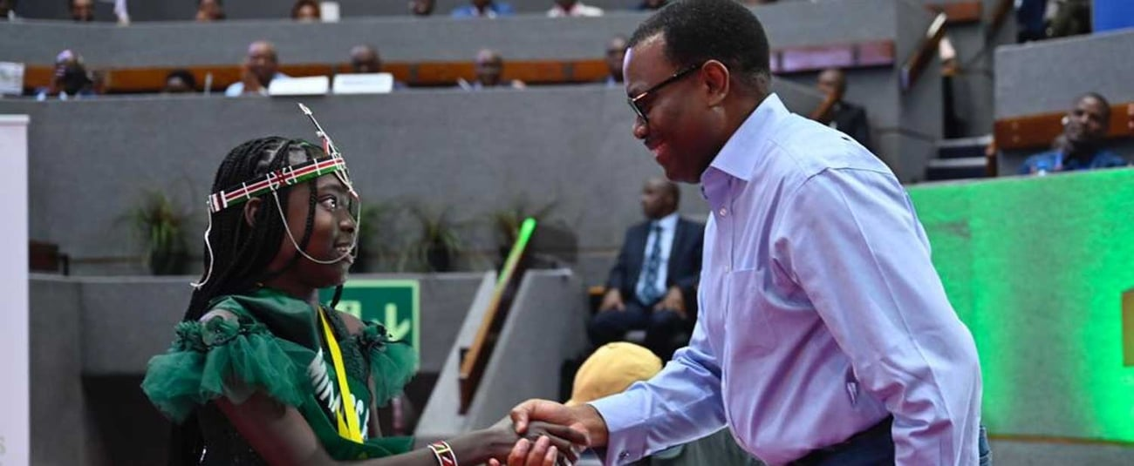
NATALIE SILANTOI ANYANGO

Slide 11
The health, development and safety of children in 98% of African countries are severely threatened by the effects of climate change- UNICEF
PROTECT THE AFRICAN CHILD BY GIVING THEM A FUTURE THEY CAN THRIVE IN & BY GIVING THEM A SEAT AT THE TABLE TO DECIDE THEIR FUTURE.

