Slide 1


RE-INVIGORATING SOCIAL WORK AND DEVELOPMENT EDUCATION AND PRACTICE FOR EFFECTIVE IMPLEMENTATION OF UBUNTU IN THE SOCIAL WORLD TODAY: The Case of Rwanda
By:
Dr Charles KALINGANIRE

Slide 2
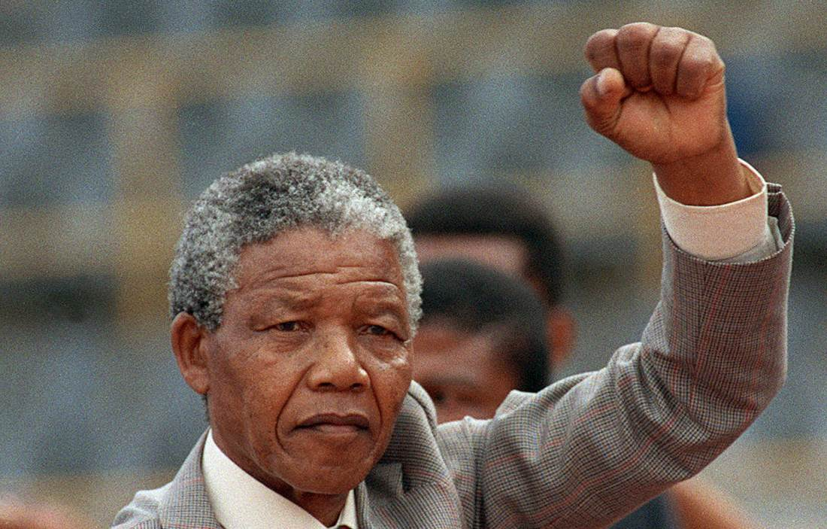
“Act locally and think globally”
“Education is
the most powerful weapon which you can use to
change the world.”
Nelson mandela .

Slide 3
Structure of the presentation
Introduction
Conceptualisation
Social Work Education and Practice (SWEP): Drawing on Ubuntu Philosophy
Case Example: SWEP in the aftermath of the Genocide Against the Tutsi in Rwanda
Rethinking SWEP: Why and How
Conclusions and Recommendations
Assignment

Slide 4

1. Introduction: The World we live in
THE WORLD = VILLAGE???
Various issues
Poverty
HIV/AIDS
Refugees
Child Welfare
Safety and self-care
Globalisation
World Population: Around 8 Billion
Various Resources
Different Opportunities
Globalisation
Haves vs. Haves not
Wealthiest vs. Needy
SOCIO ECONOMIC INEQUALITIES !!!

Slide 5
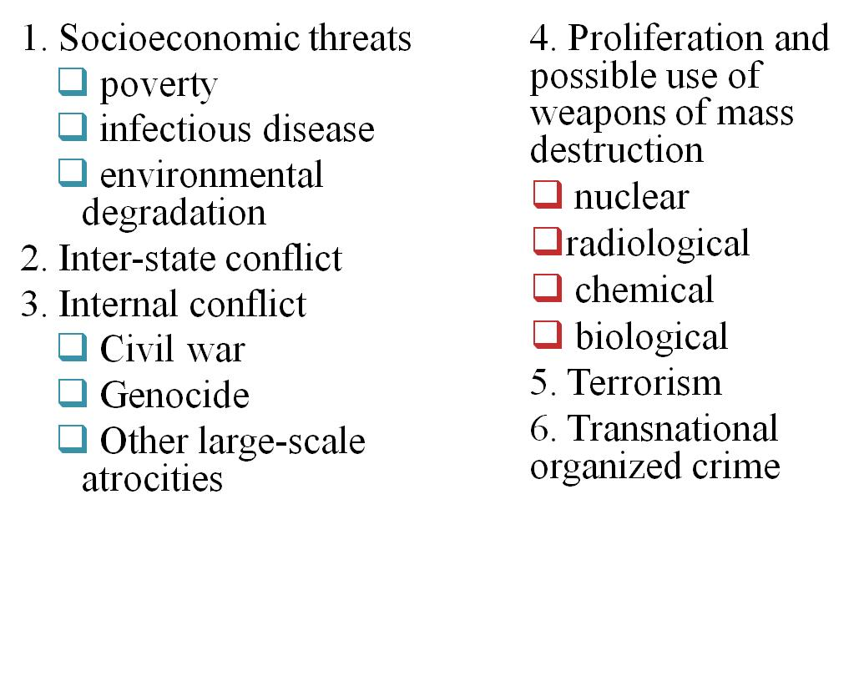

Slide 6


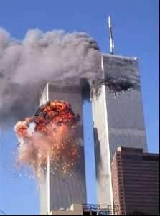
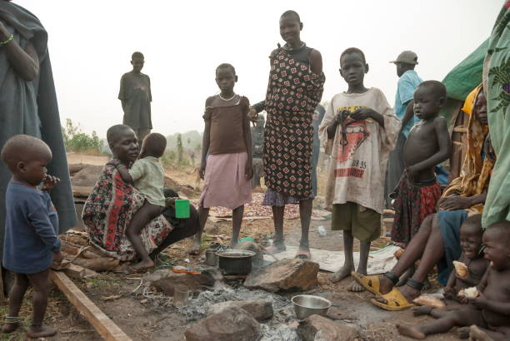
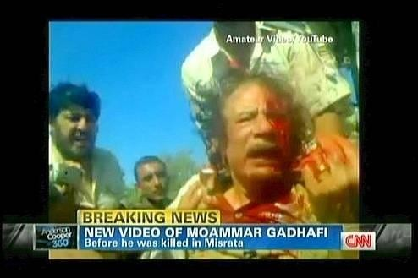
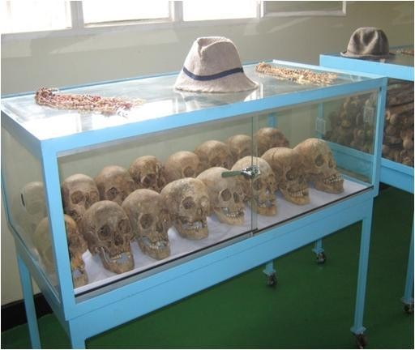
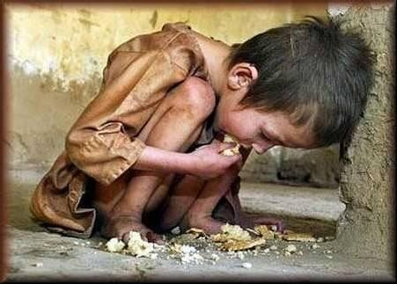
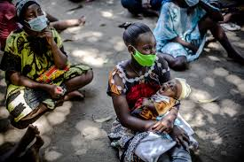
How do these cluster threats appear?

Slide 7
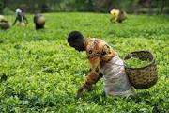
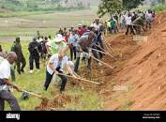

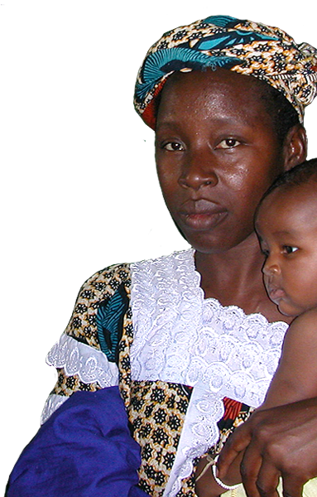
The Social World we want: “Leaving No One Behind”
IS THIS
IS THIS
POSSIBLE
YES BUT???

Slide 8
RESPONSE TO SOCIOECONOMIC THREATS
Social Work has a big Role to Play
Human Rights
Social Justice
UBUNTU (Humaninmess)
UBUTWARI (Heroism)
UBUMWE (Unity)
COMPLEMENTARY VALUES

Slide 9
2. CONCEPTUALISATION
WHAT IS SOCIAL WORK?
Social work is a practice-based profession and an academic discipline that promotes social change and development, social cohesion, and the empowerment and liberation of people. Principles of social justice, human rights, collective responsibility and respect for diversities are central to social work. Underpinned by theories of social work, social sciences, humanities and indigenous knowledges, social work engages people and structures to address life challenges and enhance wellbeing. The above definition may be amplified at national and/or regional levels.

Slide 10
What is Ubuntu?
UBUNTU is considered as an “African philosophy that places emphasis on ‘being self through others. It is a form of humanism which can be expressed in the phrases ‘I am because of who we all are’ and ubuntu ngumuntu ngabantu in Zulu language.
Ubuntu means generally “humanness” and expresses itself metaphorically as “people are people through people

Slide 11
What is Education?
According to Fresno Pacific University (2019), education is defined as “a gradual process which brings positive change in the human life and behavior. [It can also be] defined as a process of acquiring knowledge through study or imparting the knowledge by way of instruction or some other practical procedure.”

Slide 12
Education can be formal; non formal and informal
Formal: refers to organised, institutionalised learning models.
Non formal: refers to the learning from community groups (e.g. family) and other various organisations.
Informal: refers to the everyday learning people experience throughout their lives.

Slide 13
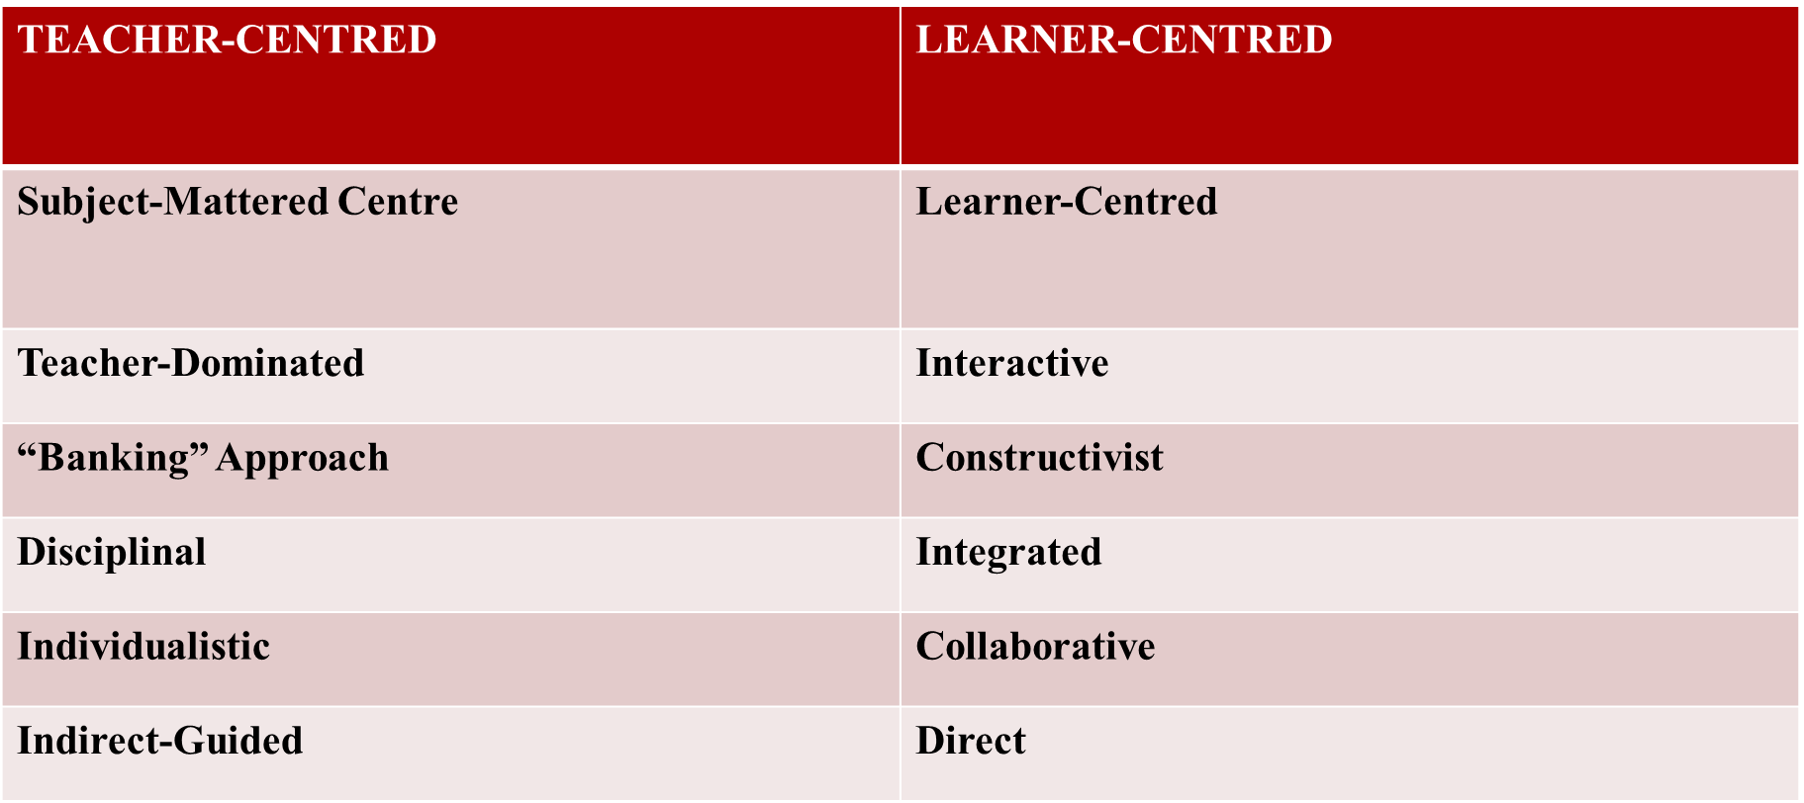
3. SWEP: Drawing on UBUNTU Philosophy
From classical to Competence and Student-Based Education

Slide 14
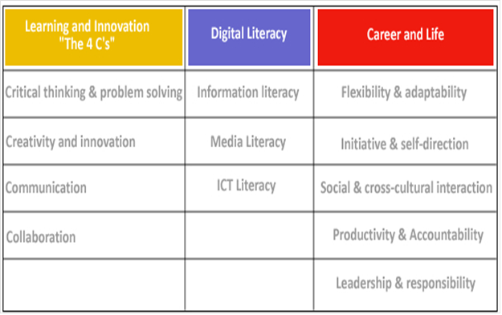
Reference to the 21st Century Skills:

Slide 15
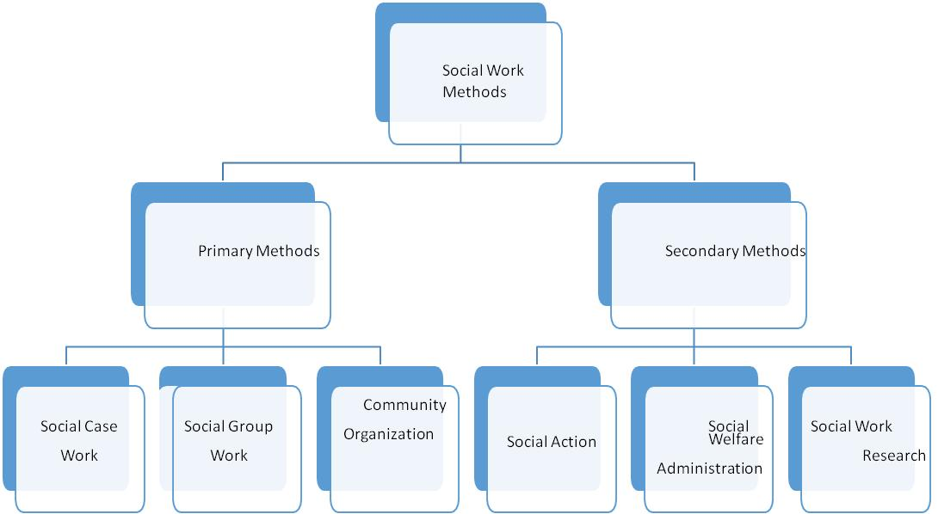
In-class Implementation of UBUNTU through Primary and Secondary Social Work Methods

Slide 16
Field Placement: Concrete ways of Implementation of UBUNTU

Slide 17
4. Case Example: SWEP in the aftermath of the Genocide against the Tutsi in Rwanda
Genesis of SWEP in Rwanda
In Rwanda, the social work was officially established as an academic
discipline in the direct aftermath of the 1994 Genocide against the Tutsi.
Since this time, the profession has been evolving and growing, drawing on a hybrid model that combines both the Western model of practice and indigenous ways of solving problems.

Slide 18
Social Work Teaching in the Framework of Home-Grown Initiatives/Solutions (HGS):
Home Grown Initiatives (HGIs) are Rwanda’s ‘trade mark’ solutions built on the Rwandan history and culture. These policies are a direct response to economic and social challenges and contribute to fulfill the developmental vision of Rwanda. The most extensive and transformative HGIs include Umuganda, Gacaca, Abunzi, Imihigo, Ubudehe, Itorero & Ingando, Umushyikirano, Umwiherero and Girinka. (RGB, 2014)

Slide 19
Key HGS that spurred Socio-Economic Development:

Slide 20

Reference to UR Graduate Attributes

Slide 22
Resorting to Participatory Methodologies
In social Sciences, particularly in Social Work:
In class:
Intergroup debates: Group presenter vs Discussant group
Moving debates
Storry telling and/or experience sharing
Situation analysis

Slide 23
2) In the field:
Meetings
Field visits / Professional practice
Community work ‘Umuganda’
Joint supervision (Field instructor & Academic supervisor)
Weekly interim presentations during the professional practices period
3) Other mechanisms
Use of new technologies: social media (group watsap; emails; SMS)
Talks at Radio Salus (University Radio)
Campaigns e.g March, advocacy (World Social Work Day), students and staff exchange with other universities

Slide 24
From the Remedial to Developmental Social Work
To rebuild the social fabric, really from the ashes, the government of Rwanda devised the people and community-centred approaches.
The Rwandan proverb “Ak’imuhana kaza imvura ihise” (It is better to be self-reliant because assistance from outside is unreliable and unpredictable) was considered a guiding principle.

Slide 25
Privilege was given to collective action
Conducive socio-political environment, leadership and adequate governance offer space for suitable social work interventions
This connotes ‘developmental social work’

Slide 26
5. Rethinking SWEP: Why and How to incorporate the UBUNTU philosophy?
To correct what has been wrong: avoiding the usurpation of the profession by sister disciplines.
To observe strictly the original vision of the profession to ‘Help people help themselves’.
To be real social change agents (Agents of Socialisation): Educators; Mobilisers; Influencers wherever we are (formal; non formal and informal actions)

Slide 27

Striving to mitigate all forms of adversities and acting towards the achievement of the SDGs
Worldwide SDGs

Slide 28
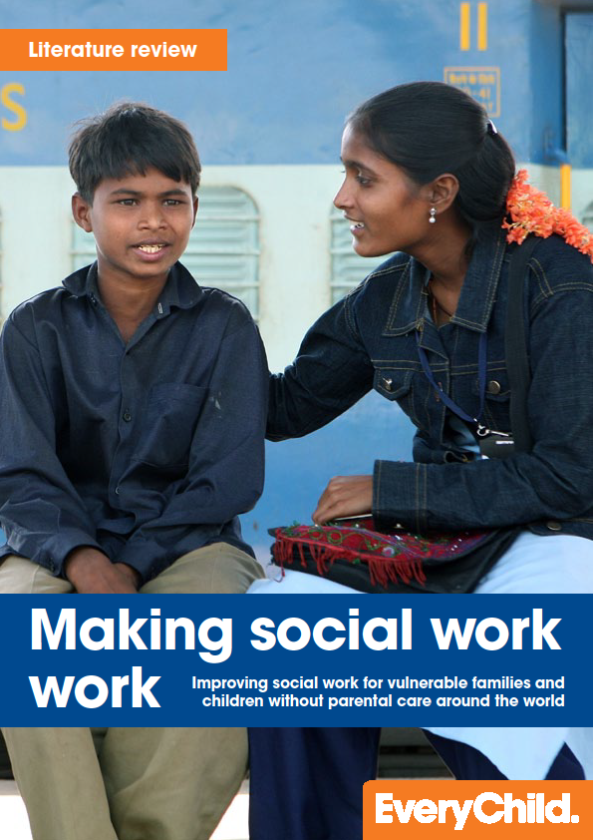
Above all for success: Involving the clients in the problem Solving Process, “making social work work” and promoting the Collective ownership of their concerns
Social workers have a responsibility to help people to:
  Help themselves
  Create change in their lives
  Recognize their strengths
  Reach out to their own resources
We, social workers in Rwanda:
“We are counsellors, community facilitators, educators, advocates and policy influencers. We work both with individuals and whole communities as the nation needs to work together to overcome the challenges.”
(A Lecturer of Social Work, 2019)

Slide 29
6. Conclusion and Recommendations
Need of Emancipatory Education: Strengthening and contextualising curricula; promoting student-competent-centered approaches (SCCA) to shape ‘Global Citizens)
Firm collaboration between junior and senior social work professionals
Decent learning environment
Paradigm shift from remedial to developmental perspectives
Overall, striving for the shaping of strong Social Service Workforce (SSW)

Slide 30
Social workers may, without endangering their expertise, work closely with well selected wise people who will be in constant contact with the people in need and report regularly to them.
Refining the social work curriculum and elaborating a well-thought Field Manual
Reinforcing synergies with Welfare agencies, administrative instances, local communities and social work bodies.
Well equipping students with adequate theories but fitting these with practice in different settings: Documenting the local/indigenous practices.

Slide 31
ASSIGNMENT

Slide 32
The social work practitioners are well positioned to ‘help PIN help themselves; create change in their lives; recognise their strengths and reach out to their own resources’.
However, they may be cognizant of their limitations to replace people they work with, particularly the PIN and to respond to the latter’s solicitations wherever and whenever necessary. They cannot always reach physically every person in need within his/her environment though this is comforting. They may partner with different stakeholders particularly from the Social Welfare Workforce (SWW) including particularly Intermediary Social Work Actors (ISWAs), usually called Para-Professionals.

Slide 33
➔Social workers may use participatory, synthesised and integrated methodologies. Here the PAR should be privileged and indigenous practices/Home Grown Initiatives (HGI) promoted in the perspective of making people aware of their responsibility in the problem-solving process.
Ak’imuhana kaza imvura ihise: It is better to be self-reliant because assistance from outside is unreliable and unpredictable

Slide 34
To help adequately people in need (PIN) requires to work with them in their respective settings where all concerned actors may strive for the betterment of all PINs who may have access to the benefits of the existing systems.
➔Social workers may be well equipped (from university already) to be able to handle different kinds of adversities at different levels and to adapt to the ever changing world: emphasising emancipatory education.
➔Embracing and putting in action the principle of “Leaving none behind”.

Slide 35
➔Social workers may challenge common sense approaches and use interpretive approaches.
➔Contributing always to the building of a decent society: playing directly or indirectly an influential role and establishing a bridge between local policy implementers and policy makers in order to fix every time emerging shortcomings.
➔Drawing on prevailing social capital within the settings under consideration.
What is asked to the PSW and the SWW on the whole is “Not to do extraordinary things but to act extraordinarily well”

Slide 36
ASSIGNMENT
OUR ROLE/RESPONSIBILITY TOWARD THE END OF THIS YEAR AND THE WORLD SOCIAL WORK DAY IN MARCH 2025??

Slide 37
Book chapter

Slide 38
Chitereka, C. (2009). Social work practice in a developing continent: The case of Africa. Advances in Social Work, 10(2), 144–156.
Cox, L E.; Tice, C J.; Long, D. D. (2015). Introduction to social work: An advocacy-based profession. London: Sage Publications.
Cusack, C. et al. (2018). Participatory Action as a Research Method with Public Health Nurses. Journal of Advanced Nursing, 74, 1544–1553.
Gasker, J. (2019). GeneralistSocial Work Practice. Sage Publications, Inc.
Gray, M. (2017). Handbook of social work and social development in Africa (Routledge). London.

Slide 39
Kalinganire, C., Gilkey, S. and Haas, L. (2017). Social work practice in Rwanda: The challenges of adapting Western models to fit local contexts. In M. Gray (Ed.), Handbook of Social Work and Social development in Africa (pp. 315–327). London: Routledge.

Slide 40
Twikirize, J.M. & Spitzer, H. (2019). Social Work Practice in Africa: Indigenous and Innovative Approaches. Kampala: Fountain Publishers.

Slide 41


Slide 42
THANKS!
MERCI!
MURAKOZE!

